Slide 1
Data Link Layer Protocols

Slide 2
Flow Control
Ensuring the sending entity does not overwhelm the receiving entity
  Preventing buffer overflow
Transmission time
  Time taken to emit all bits into medium
Propagation time
  Time for a bit to traverse the link

Slide 3
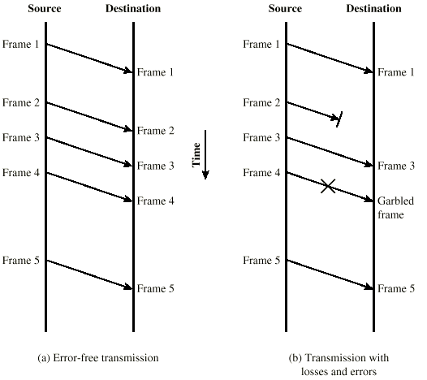
Model of Frame Transmission

Slide 4
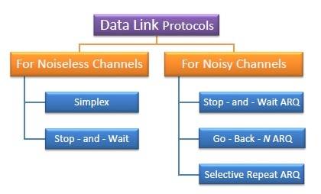
Data link protocols can be broadly divided into two categories, depending on whether the transmission channel is noiseless or noisy.

Slide 5
Simplex Protocol
The Simplex protocol is hypothetical protocol designed for unidirectional data transmission over an ideal channel, i.e. a channel through which transmission can never go wrong.
It has distinct procedures for sender and receiver.
The sender simply sends all its data available onto the channel as soon as they are available in its buffer.
The receiver is assumed to process all incoming data instantly.
It is hypothetical since it does not handle flow control or error control.

Slide 6
Initial Assumptions
Simplex Channel
Infinite buffer capacity with the receiver
Error free transmission
Network layer at the senders end is always ready with data
No need for flow control

Slide 7
Unrestricted Simplex Protocol – the Utopia
Both the transmitting and receiving network layers are always ready
Framing only
No error or flow control
  Infinite buffer space is available
  The communication channel between the data link layers never damages or loses frames
Data are transmitted in one direction only
Processing time can be ignored

Slide 8
Unrestricted Simplex Protocol
void sender1 (void)
{
  frame s;
  packet buffer;
  while (true) {
  from_network_layer(&buffer);
  s.info = buffer;
  to_physical_layer(&s);
  }
}

Slide 9
void receiver1 (void)
{
  frame r;
  event_type event;
  while (true) {
  wait_for_event(&event);
  from_physical_layer(&r);
  to_network_layer(&r.info);
}
}

Slide 10
Stop – and – Wait Protocol
Stop – and – Wait protocol is for noiseless channel.
It provides unidirectional data transmission without any error control facilities.
However, it provides for flow control so that a fast sender does not drown a slow receiver.
The receiver has a finite buffer size with finite processing speed.
The sender can send a frame only when it has received indication from the receiver that it is available for further data processing.

Slide 11
Stop and Wait
Send one packet & Wait for Ack before proceeding
  Source transmits frame
  Destination receives frame and replies with acknowledgement
  Source waits for ACK before sending next frame
  Destination can stop flow by not send ACK
  Works well for a few large frames

Slide 12
Simplex Stop-and-Wait Protocol
Assumptions
Finite buffer
The communication channel between the data link layers never damages or loses frames
Data are transmitted in one direction only
Processing time can be ignored

Slide 13
Simplex Stop-and-Wait Protocol
void sender2 (void)
{
  frame s;
  packet buffer;
  event_type event;
  while (true) {
  from_network_layer(&buffer);
  s.info = buffer;
  to_physical_layer(&s);
  wait_for_event(&event);
  }
}

Slide 14
void receiver2 (void)
{
  frame r, s;
  event_type event;
  while (true) {
  wait_for_event(&event);
  from_physical_layer(&r);
  to_network_layer(&r.info);
  to_physical_layer(&s);
  }
}

Slide 15
A Simplex Protocol for a Noisy channel
Assumptions
Finite Buffer
A positive acknowledgement with retransmission protocol.
Data are transmitted in one direction only
Processing time can be ignored

Slide 16
Automatic Repeat request (ARQ) protocols
Positive Ack
1-bit sequence number in frames (not in acks)
Timeout to detect lost frames/acks
Retransmission
Can fail under early timeout conditions
Full Duplex Communication
Piggybacking of acks
  Temporarily delaying outgoing acknowledgements so that they can be hooked onto the next outgoing data frame

Slide 17
Stop – and – Wait ARQ
Stop – and – wait Automatic Repeat Request (Stop – and – Wait ARQ) is a variation of the Stop –and- wait protocol with added error control mechanisms, appropriate for noisy channels.
The sender keeps a copy of the sent frame.
It then waits for a finite time to receive a positive acknowledgement from receiver.
If the timer expires or a negative acknowledgement is received, the frame is retransmitted.
If a positive acknowledgement is received then the next frame is sent.

Slide 18
Fragmentation
Large block of data may be split into small frames
  Limited buffer size
  Errors detected sooner (when whole frame received)
  On error, retransmission of smaller frames is needed
  Prevents one station occupying medium for long periods
Stop and wait becomes inadequate

Slide 19
Sliding Windows Flow Control
Allow multiple frames to be in transit
Receiver has buffer W long
Transmitter can send up to W frames without ACK
Each frame is numbered
ACK includes number of next frame expected
Sequence number bounded by size of field (k)
  Frames are numbered modulo 2^{k}

Slide 20
Sliding Window Protocols
Window = Set of sequence numbers to send/receive
Sender window
  Sender window increases when ack received
  Packets in sender window must be buffered at source
  Sender window may grow in some protocols
Receiver window
  Packets outside window discarded
  Window advances when sequence number = low edge of window received
  Receiver window always constant
  Sender transmits W frames before blocking (pipelining)

Slide 21
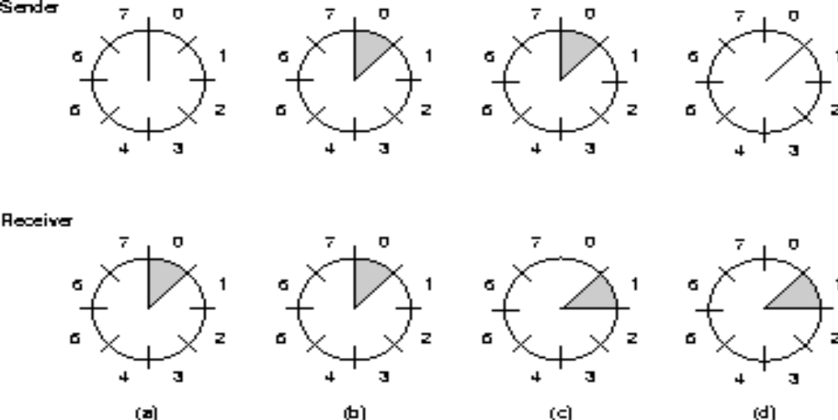

Slide 22
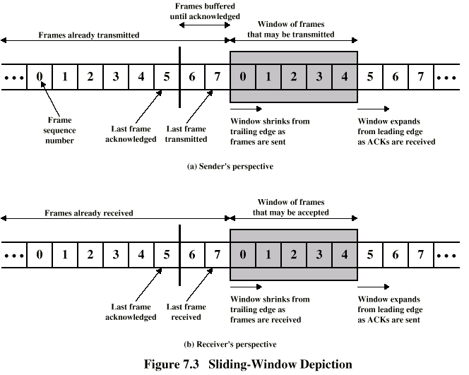
Sliding Window Diagram

Slide 23
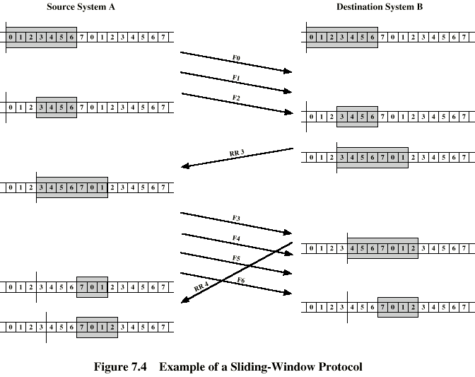
Example Sliding Window
F - Frame
RR – Receive Ready

Slide 24
Sliding Window Protocols
A One-Bit Sliding Window Protocol
A Protocol Using Go Back N
A Protocol Using Selective Repeat

Slide 25
One-Bit Sliding Window
Stop and Wait + error control
Piggybacked acks
Acks sent instantly
Packets may be resent to accommodate immediate piggybacking
Acks contain sequence number
Peculiar case: when both sides start simultaneously

Slide 26
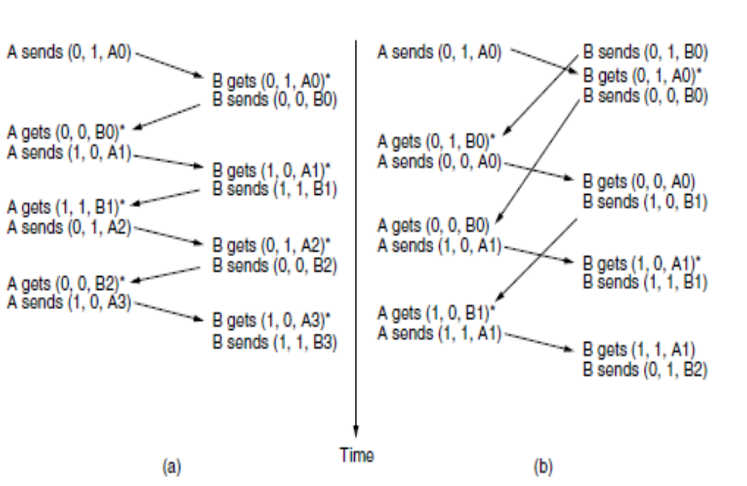
Two scenarios
(a) Normal case.
(b) Abnormal case.
The notation is (seq, ack, packet number). An asterisk indicates where a network layer accepts a packet.

Slide 27

Sliding Window Protocol(Duplex)
  At any instant of time, the sender & receiver maintain a set of sequence numbers corresponding to frames it is permitted to send/receive
  Piggybacking
  Pipelining

Slide 28
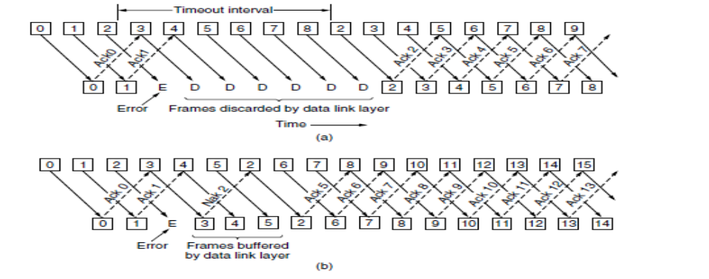
Pipelining and error recovery. Effect of an error when
(a) receiver’s window size is 1 and (b) receiver’s window size is large.

Slide 29
Go – Back – N ARQ
Go – Back – N ARQ provides for sending multiple frames before receiving the acknowledgement for the first frame.
It uses the concept of sliding window, and so is also called sliding window protocol.
The frames are sequentially numbered and a finite number of frames are sent.
If the acknowledgement of a frame is not received within the time period, all frames starting from that frame are retransmitted.

Slide 30
Round trip propagation + transmission time not negligible, Stop and Wait is not efficient
Sender is allowed to transmit multiple packets without waiting for an acknowledgement, but is constrained to have no more than some maximum allowable number (N)
Use cumulative acknowledgement
Ack the latest packet (N) if all packets (< N) are received.
Discard out-of-order packets, no receiver buffering
  Sliding Window + Retransmit all packets starting from earliest unacked packet
Can waste a lot of bandwidth if error rate high

Slide 31
Selective Repeat ARQ
This protocol also provides for sending multiple frames before receiving the acknowledgement for the first frame.
However, here only the erroneous or lost frames are retransmitted, while the good frames are received and buffered.

Slide 32
Selective Repeat
Sliding Window + Retransmit just the bad frame when Nak received
Out-of-order buffering required at destination
Loses time (and hence throughput) if bursty loss of frames
Acks not cumulative.
Non-sequential arrival of packets
  ensure no overlap with old window when receiver advances window
  Maximum Window = (Sequence Number Space)/2

Slide 33
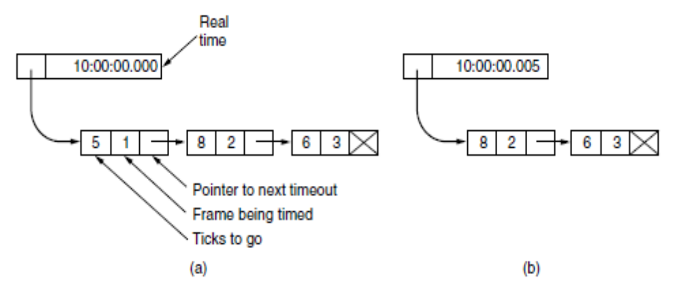
Out-of-order buffering not mandatory at destination
Maximum Window = Sequence Number Space - 1
N timers or 1 timer may be used
Simulation of multiple timers in software. (a) The queued timeouts.
(b) The situation after the first timeout has expired.

Slide 34
Enhancement to piggybacking
Auxiliary Ack timer
Set timer when packet to be acked is received
If no reverse data, generate Ack when timer goes off
Send negative ack (Nak) when out-of-order frame received
Source retransmits Nak’ed frame
Naks not cumulative
Do not send duplicate Nak

Slide 35
Sliding Window Enhancements
Receiver can acknowledge frames without permitting further transmission (Receive Not Ready)
Must send a normal acknowledge to resume
If duplex, use piggybacking
  If no data to send, use acknowledgement frame
  If data but no acknowledgement to send, send last acknowledgement number again, or have ACK valid flag (TCP)

